Slide 1

Predicting Customer Satisfaction in the Airline Industry
Team 6 – Joshua Farina (joshuapfarina), Henri Salomon (henri_salomon), Raajitha Middi (Raajitha_Middi), Ryan Chandler (zujin87), Alejandro Martinez (amzeta)
Notes:
(~1:30)
Hello, my name is John Doe A from Team 6 and I will be introducing our project about predicting customer satisfaction in the airline industry and giving you an overview of our dataset.

Slide 2


Project Overview
Use customer satisfaction survey results to identify the most important factors that lead to customer satisfaction.
Customer satisfaction is a key factor in attracting and retaining business.
By understanding the crucial factors that drive customer satisfaction airlines can allocate resources to optimize business operations.
Notes:
We used a dataset consisting of airline passenger satisfaction survey results to understand which factors are most important to customers and provide recommendations to airlines on how money should be invested or re-allocated to increase customer satisfaction.
Customer satisfaction is a main driver in attracting and retaining business. By finding the most important factors we can provide key insights for airlines to enhance their services, improve the customer experience, and optimize business operations in order to differentiate themselves from the competition.
Some estimates indicate that increasing customer retention by as little as 5% increases profits by 25-95%.

Slide 3
Dataset Overview
Notes:
Here is an overview of our dataset which is publicly available on Kaggle. It contains user ratings for multiple aspects of air travel.
Not shown is the target variable which is a binary value for whether the customer was satisfied.

Slide 4
Dataset Overview - Hypotheses
Notes:
Our initial hypothesis was that flight distance, inflight wifi service, departure/arrival time convenience, food and drink, seat comfort, inflight entertainment, on-board service, legroom service, inflight service, departure delays in minutes, and arrival delays in minutes would be the most important factors. Additionally, we hypothesized that the relevance of these factors will vary depending on the class, type of travel, demographic factors (such as , age and gender), and flight distance.

Slide 5
Dataset Overview - Preparation
Notes:
(~1:30)
Hello I am John Doe B and I will talk about our data preparation and cleaning.
The variables between the brackets are Likert Scale values, this means that they take an integer value between zero and five with five being the best rating. Zero indicates that the customer did not rate that feature. The remaining values are continuous integer values.
We split the training data into a training and validation set, additionally a separate test set is already provided. The final split is approximately sixty percent training data, twenty percent validation data, and twenty percent test data. The validation data was used for hyperparameter tuning and final model selection and the test data was used to check the final accuracy of the selected model.

Slide 6
Dataset Overview - Cleaning
Notes:
Arrival delay in minutes had 310 missing values and since it is highly correlated with departure delay in minutes we decided to exclude it from our models. There was also a customer id number which we eliminated since it provides no useful information for modeling.
Some of the Likert scale variables had a zero, meaning that they weren’t rated. This accounted for less than 5% of the total data for each variable. We replaced those values with their corresponding mode values calculated on the training data set only. The mode values calculated from the training data set were then used to fill in the zero values on the validation and test set.
Finally, we applied various transformations such as log, square root, and box-cox to numeric variables Flight.Distance and Departure.Delay.in.Minutes to normalize the data. We settled on a Log transformation which did improve the distributions but did not lead to a normal distribution.

Slide 7
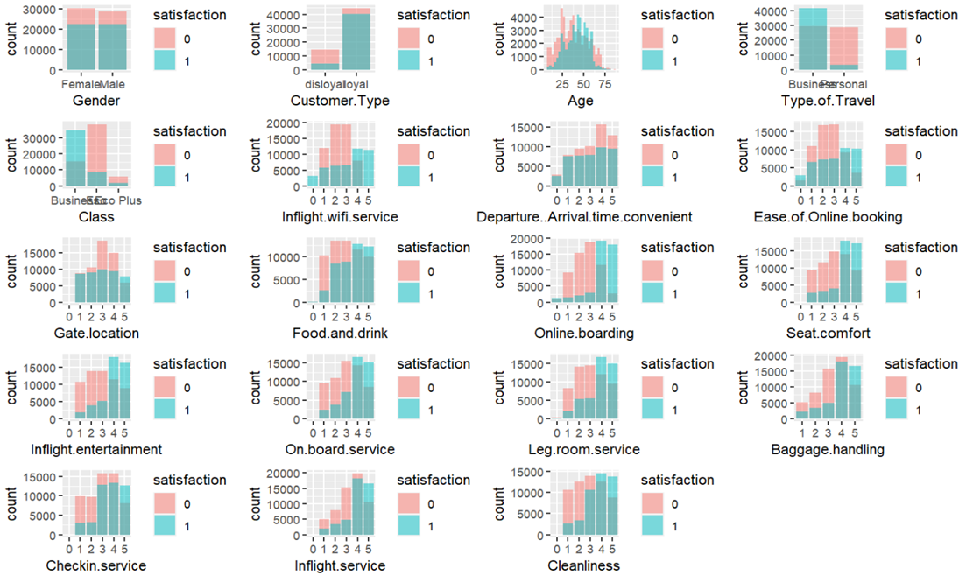
Dataset Overview – Exploratory Data Analysis
Gender doesn’t seem to play a major role in satisfaction as both have almost the same satisfaction levels.
F
M
Notes:
(~2:15)
Hello, I am John Doe C and I will talk about our exploratory data analysis and modelling approach.
As an initial step in exploratory data analysis we created overlayed graphs for each feature showing the number of satisfied and unsatisfied customers. In this example, we can see that the ratings are very similar for both genders, indicating that gender does not play a major role in satisfaction.

Slide 8
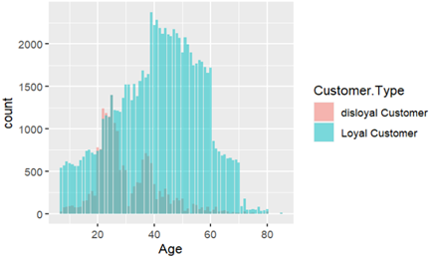
Dataset Overview – Exploratory Data Analysis
Younger travelers are more likely to be dissatisfied
Notes:
Younger travelers are more likely to be dissatisfied, with people in the age group of approximately twenty to thirty five being more dissatisfied than any other age group. Interestingly, people in this age group are more likely to be disloyal.

Slide 9
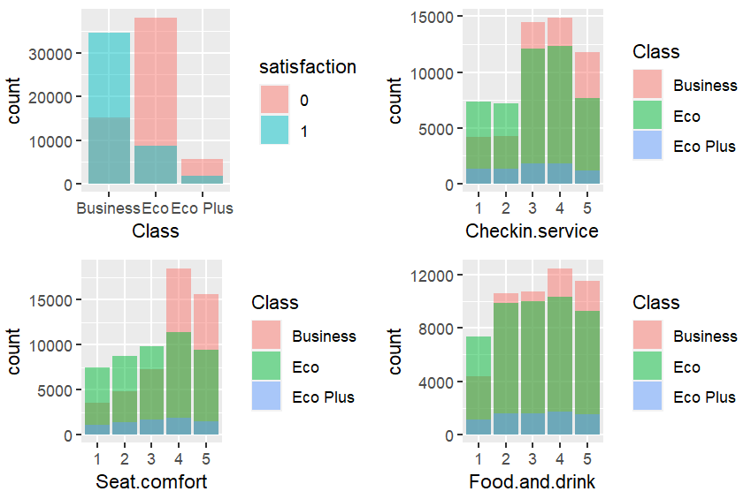
Dataset Overview – Exploratory Data Analysis
Business class passengers have higher satisfaction levels, particularly in Checkin.service, Seat.Comfort, and Food.and.drink compared to Eco Plus and Economy class
Notes:
Business class passengers are overwhelmingly more likely to be satisfied whereas economy and economy plus passengers are highly likely to be unsatisfied.

Slide 10
Dataset Overview – Exploratory Data Analysis
Cleanliness does not translate to passenger satisfaction
Notes:
Low cleanliness values of 1 and 2 are highly likely to lead to low satisfaction but once cleanliness is acceptable at 3 or above it does not seem to have a significant effect in creating additional satisfaction.

Slide 11
Dataset Overview – Exploratory Data Analysis
Passengers express greater dissatisfaction with services like Inflight.wifi.service, Inflight.entertainment, Baggage.handling, On.board.service, Inflight.service.
Notes:
Passengers express greater dissatisfaction with services like Inflight.wifi.service, Inflight.entertainment, Baggage.handling, On.board.service, and Inflight.service. The ratings for these services need to be above 3 to increase satisfaction levels and even then it’s approximately a fifty fifty split on whether customers will be satisfied.

Slide 12
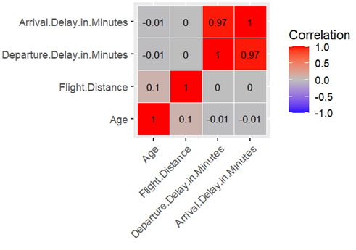
Dataset Overview – Exploratory Data Analysis
Notes:
We performed different correlation analyses. Shown here are the correlations for the numeric variables. This shows that Arrival.Delay.in.Minutes and Departure.Delay.in.Minutes are highly correlated.

Slide 13
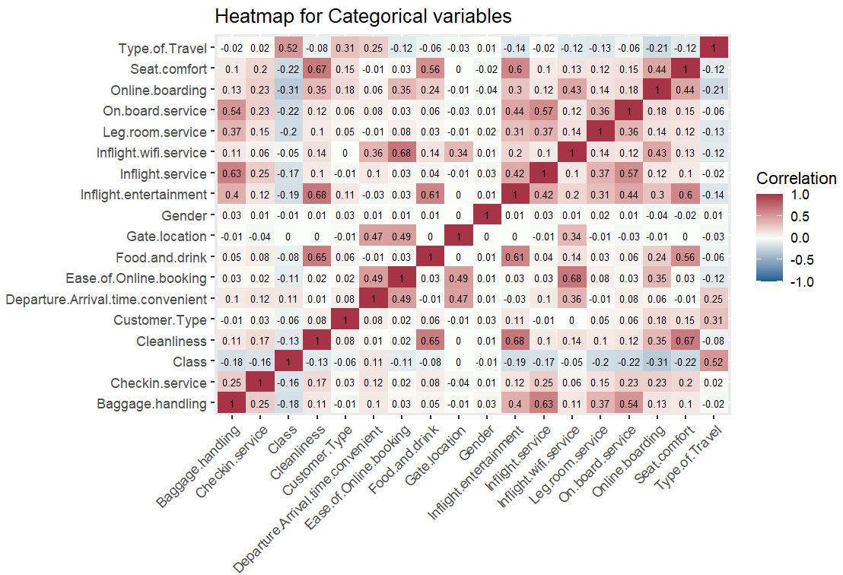
Dataset Overview – Exploratory Data Analysis
Notes:
Shown here is a heat map for the categorical variables. Most values are not highly correlated but there are a few exceptions with correlation nearing 0.7 such as Cleanliness to Food.and.drink, Inflight.entertainment, and Seat.comfort. There is also a high correlation between Inflight.wifi.service and Ease.of.Online.booking.

Slide 14
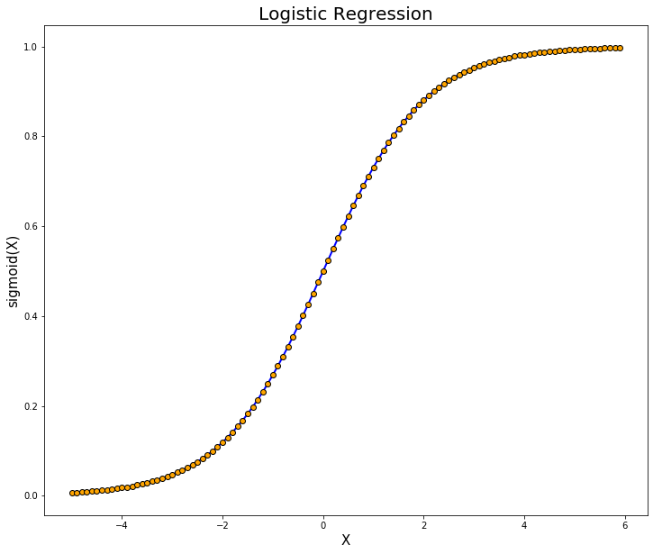
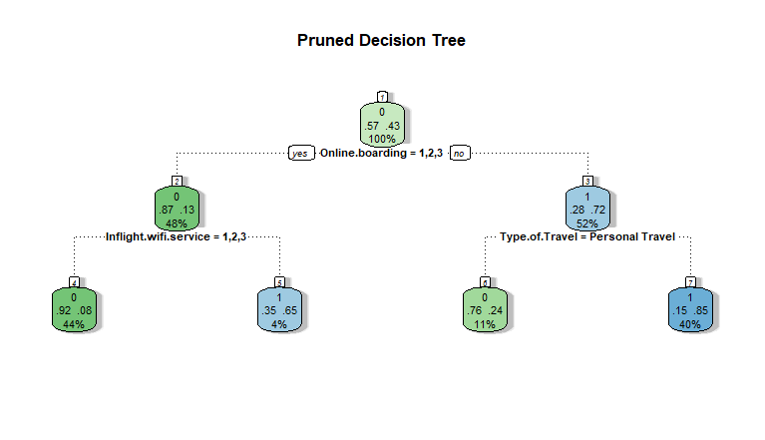
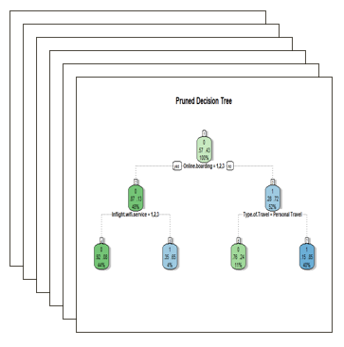
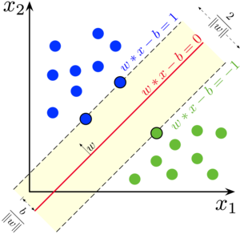
Modeling
Notes:
For modeling we decided to use Logistic Regression, Decision tree, Random Forest, and Support Vector Machines (SVM). We interpreted the results of each model, examined the significance of variables and drew conclusions regarding their impact on passenger satisfaction. We compared the models through the Receiver Operating Characteristic (ROC) curve and computed the Area Under the Curve (AUC).
We chose these models because we expected to be able to rank feature importance from the results.

Slide 15
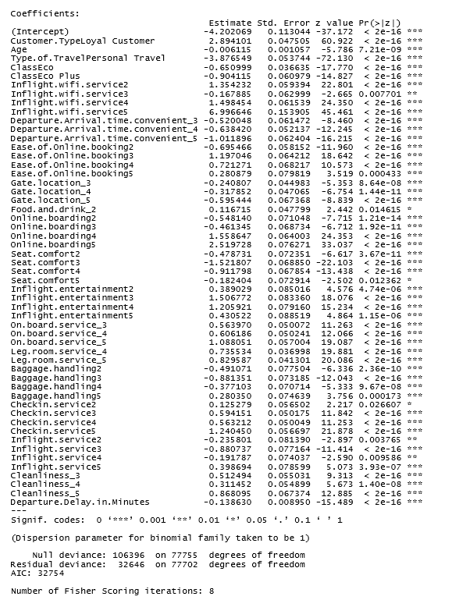
Modeling – Logistic Regression
Notes:
(~1:45)
Hello I am John Doe D and I will talk about our regression and random forest results.
For logistic regression, we used forward selection meaning that we systematically tested variables individually, assessed their distributions, and considered transformations if needed. Forward selection determined that the only feature that could be dropped was flight distance. We re-ran the model without flight distance and found that some classes such as Inflight.wifi.service_2 and On.board.service_2 were insignificant. We removed the insignificant classes and ended up with the model shown here where all classes are significant.
We consider the most important factors to be the ones with the largest coefficients, for instance loyal customers are significantly more likely to be satisfied than disloyal ones, having very good inflight wifi service of 5 significantly improves the odds of being satisfied, and having a good online boarding process of 4 or 5 increases the odds of being satisfied. People traveling for personal reasons instead of business travel are significantly more likely to be unsatisfied.

Slide 16
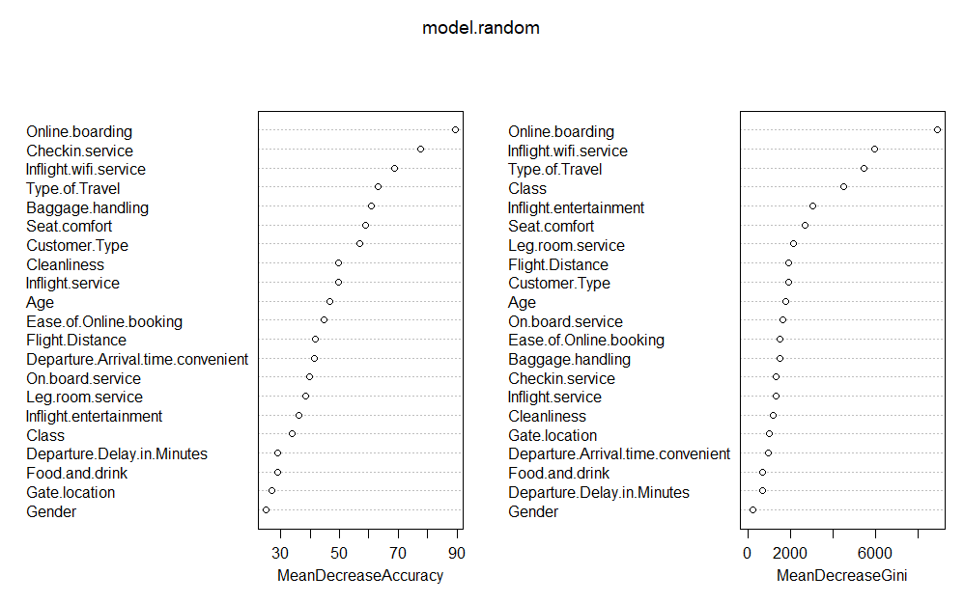
Modeling – Random Forest
Notes:
The primary random forest factors were decided using each parameter’s importance. The random forest model’s most important factors are Checkin.service, Inflight.wifi.service, Type.of.Travel, Seat.comfort.
Baggage.handling, Online.boarding, and Customer.Type have very similar importance levels. These factors were chosen as they all have an importance of 60 or higher.
Optimization of the model included plotting the error convergence and testing how many predictors to try at each split. It was found that the error had converged around 100 trees so 250 were selected to make sure any anomalies would be captured. The best number of factors to test at each split was 13 but the out-of-bag error rate decreased by less than 1% as compared to the default setting of 4.

Slide 17
Modeling – Decision Tree
Notes:
(~2:10)
Hello I am John Doe E and I will talk about our Decision Tree and Support Vector Machines results.
The decision tree model provides an easy to explain model. With an accuracy of 86.2%, it provides good insight and predictability of overall customer satisfaction. Based on the decision tree model, the top factors are Online.boarding, Inflight.wifi.service, and Type.of.Travel. The model shows that a score of 3 or below for Online.boarding and Inflight.wifi.service generally leads to an unsatisfied customer indicating that a focus on connectivity and easy online boarding will lead to an overall higher number of customers being satisfied.

Slide 18
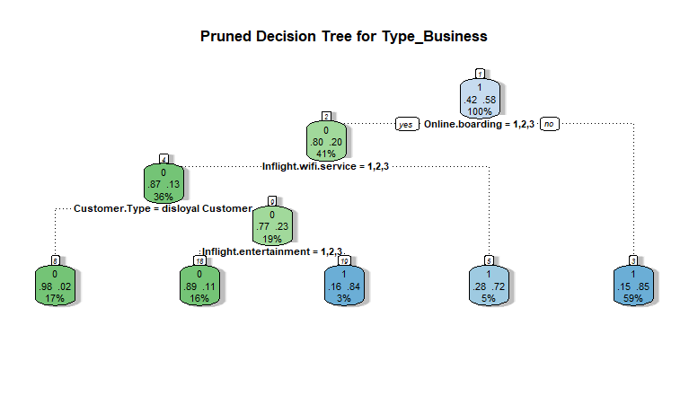
Modeling – Decision Tree
Notes:
Models exploring a single Class or Type.of.Travel were not as accurate as the “all data” model overall but did have a few insights. The Business Type of travel has an accuracy of 74.3% with a pruned tree of 4 splits as compared to the original model with 7 splits with an accuracy of 76.2%. It seems that Business travelers have a higher expectation for Inflight.entertainment than Personal travelers. The expectation of Inflight.entertainment is reinforced when grouping Business Class travelers. It should also be noted that there are over twice as many business travelers than personal travelers in the dataset.

Slide 19
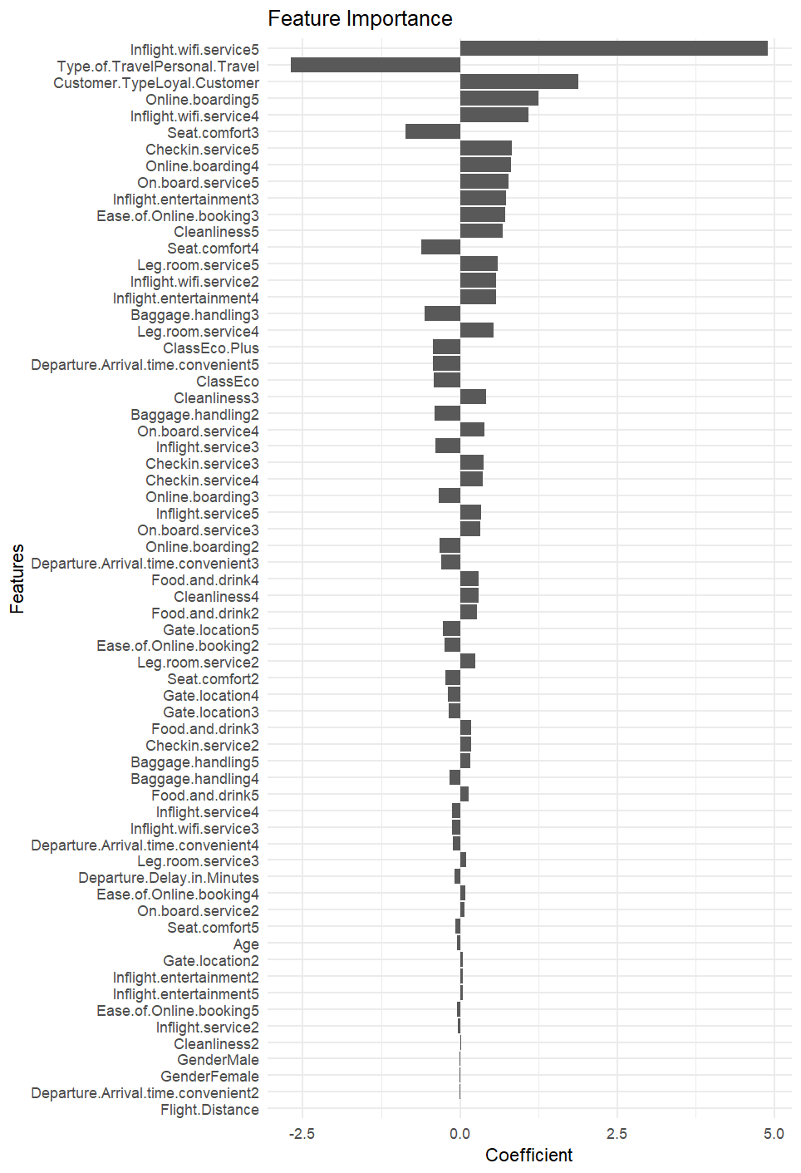
Modeling – Support Vector Machines
Notes:
We adopted a sub-sampling approach in training our SVM utilizing a small section of 15,000 randomly selected observations from the overall training set. The reason for this limitation was SVM’s known tendency to scale poorly to larger datasets. For the kernel, we selected a linear kernel for its interpretability relative to other kernels.
Models were compared by varying the penalty parameter, C, within a range of 0.001 to 100. The results demonstrated a trend of improving accuracy and AUC up to approximately C=1. Beyond this point, further increases in C yielded only marginal enhancements, while the time to train became prohibitive.
The strong results show that our data is linearly separable by the SVM model. Extracting the coefficients shows that Inflight WiFi Service of 5, Type of Travel, and Customer Type to be the most important factors. Remaining factors show a gradual decrease in relevance

Slide 20
Modeling - Summary
Model | Most Important Features | Accuracy and Other Metrics
Logistic Regression with Forward Selection | Online.boarding4 and 5 (+) Type.of.Travel Personal Travel (-) Inflight.wifi.service4 and 5 (+) Customer.TypeLoyal (+) | Accuracy: 91.9% (validation) Validation AUC: 0.971 Test AUC: 0.972
Random Forest | Checkin.service, Inflight.wifi.service, Type.of.Travel, Seat.comfort, Baggage.handling, Online.boarding, Customer.Type | Accuracy: 91.2% (validation) AUC: 0.959 Out-Of-Bag Error: 8.9%
Decision Tree | Online.boarding Inflight.wifi.service Type.of.Travel | Accuracy: 86.2% (validation) AUC: 0.886
SVM | Inflight.wifi.service5 (+) Type.of.Travel Personal Travel (-) Customer.TypeLoyal (+) Online.boarding5 (+) | Accuracy: 92.2% (validation) AUC: 0.969
Notes:
(~0:35)
Hello, John Doe B again.
Here is a summary of the model performance. The highest AUC was reached by Logistic Regression with 0.971 so this was our selected model, it performed very similarly on the test set with an AUC of 0.972. The most important features are very consistent across all models with online boarding, inflight wifi service, and type of travel showing up in all four models and Customer type loyal showing up in all but the decision tree model. The ranking of each feature varies by model but the top features are consistent.
It is interesting to note that seat comfort only appeared as important in the Random Forest model. This was surprising because a lot of the research suggests that this should be a top contributor.

Slide 21
Conclusions
The most important features that increase airline passenger satisfaction are Customer.TypeLoyal, inflight.wifi.service5, and online.boarding4 and 5.
People that travel for personal reasons are significantly more likely to be dissatisfied.
Investing in complimentary wifi would be a worthwhile investment
Money may be better spent trying to attract business travelers instead of people traveling for personal reasons.
Notes:
(~1:00)
Hello, John Doe A again.
We have concluded that the most important features that increase airline passenger satisfaction are Customer.TypeLoyal, inflight.wifi.service, and online.boarding.
People that travel for personal reasons are significantly more likely to be dissatisfied.
Wifi service and online boarding can be controlled by airlines. This would suggest that investing in good complimentary high speed wifi would be a worthwhile investment since it would lead to higher customer satisfaction and potentially increase the number of loyal customers which are also more likely to be satisfied. Further investments could be made to improve the online boarding process for customers so that it is easier and faster which would also lead to increased satisfaction.
Airlines have no control over whether people are traveling for personal or business reasons. But these findings suggest that money may be better spent trying to attract business travelers instead of people traveling for personal reasons.

Slide 22
Sources
https://www.forbes.com/sites/forbesbusinesscouncil/2022/12/12/customer-retention-versus-customer-acquisition/?sh=3cef46fc1c7d
https://www.kaggle.com/datasets/teejmahal20/airline-passenger-satisfaction
https://www.sciencedirect.com/science/article/pii/S0969699723000844#bib20
https://www.sciencedirect.com/science/article/abs/pii/S0969699719302959
https://www.sciencedirect.com/science/article/pii/S2352340923002421
https://psycnet.apa.org/record/1989-10632-001
https://www.techscience.com/cmc/v75n1/51460/pdf
Notes:
These are the sources that we used for our research and datasets.
Thank you for your time and have a great day!

